Slide 1
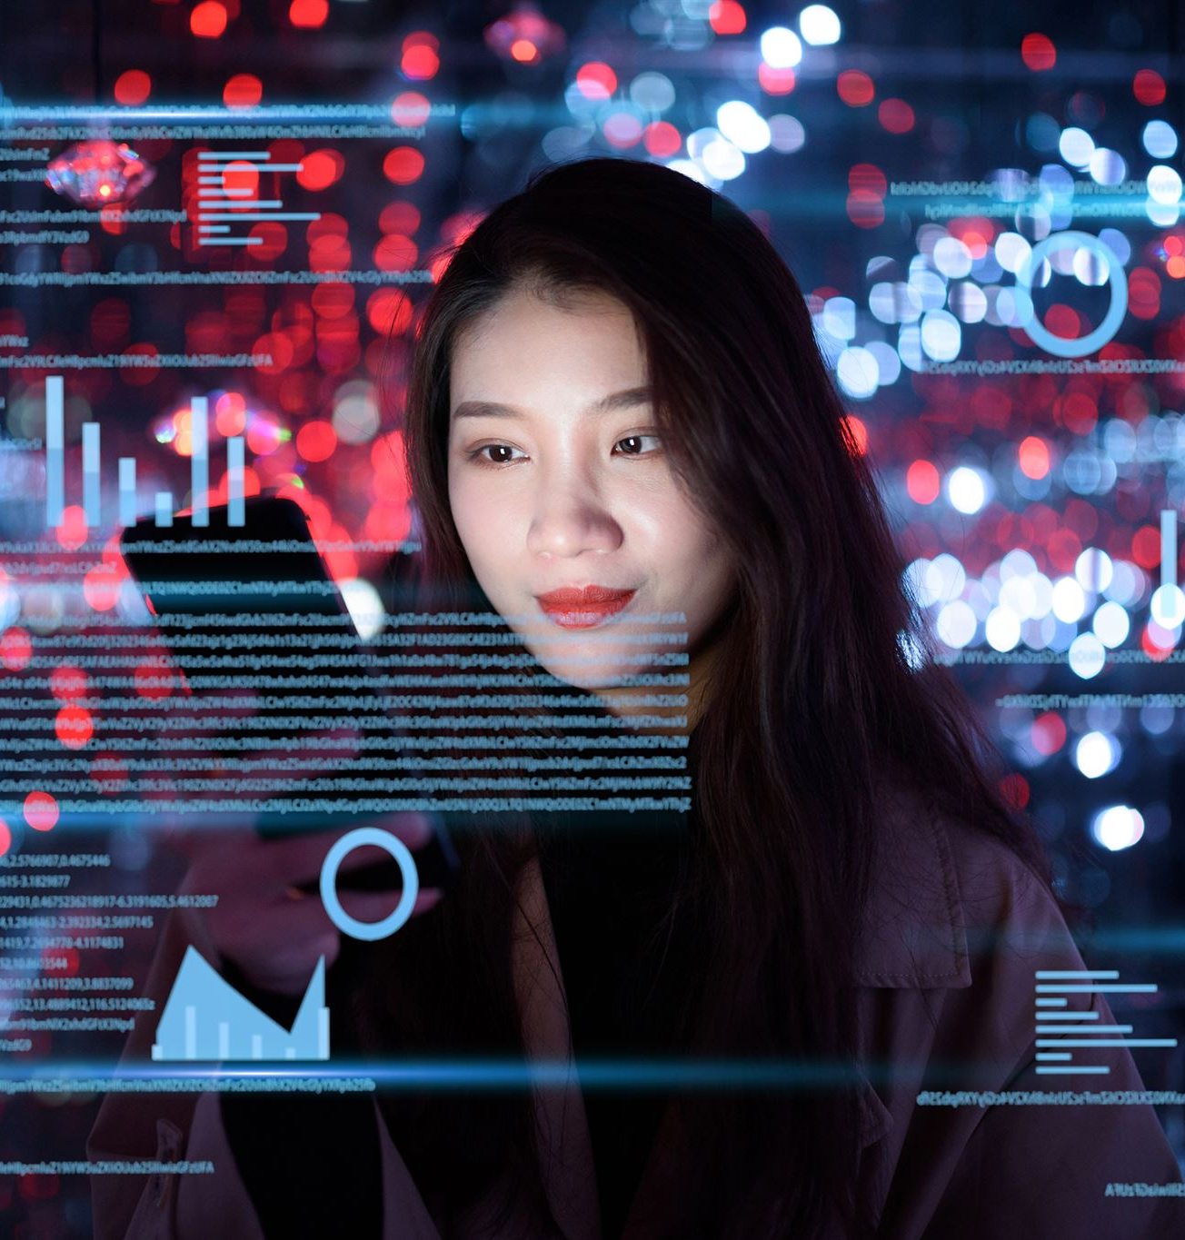
AI in Entertainment and Media: Transforming Creativity and Consumption
6253-ITAI-2372 Alfredo, Khizar, Ola, Richard
6/25/2022
Notes:
AI-generated content may be incorrect. --- Artificial Intelligence is revolutionizing the entertainment and media industries, reshaping how content is created and consumed. This presentation will explore the role of AI in various aspects of entertainment, from content generation to audience engagement. Image source: Microsoft 365 content library

Slide 2
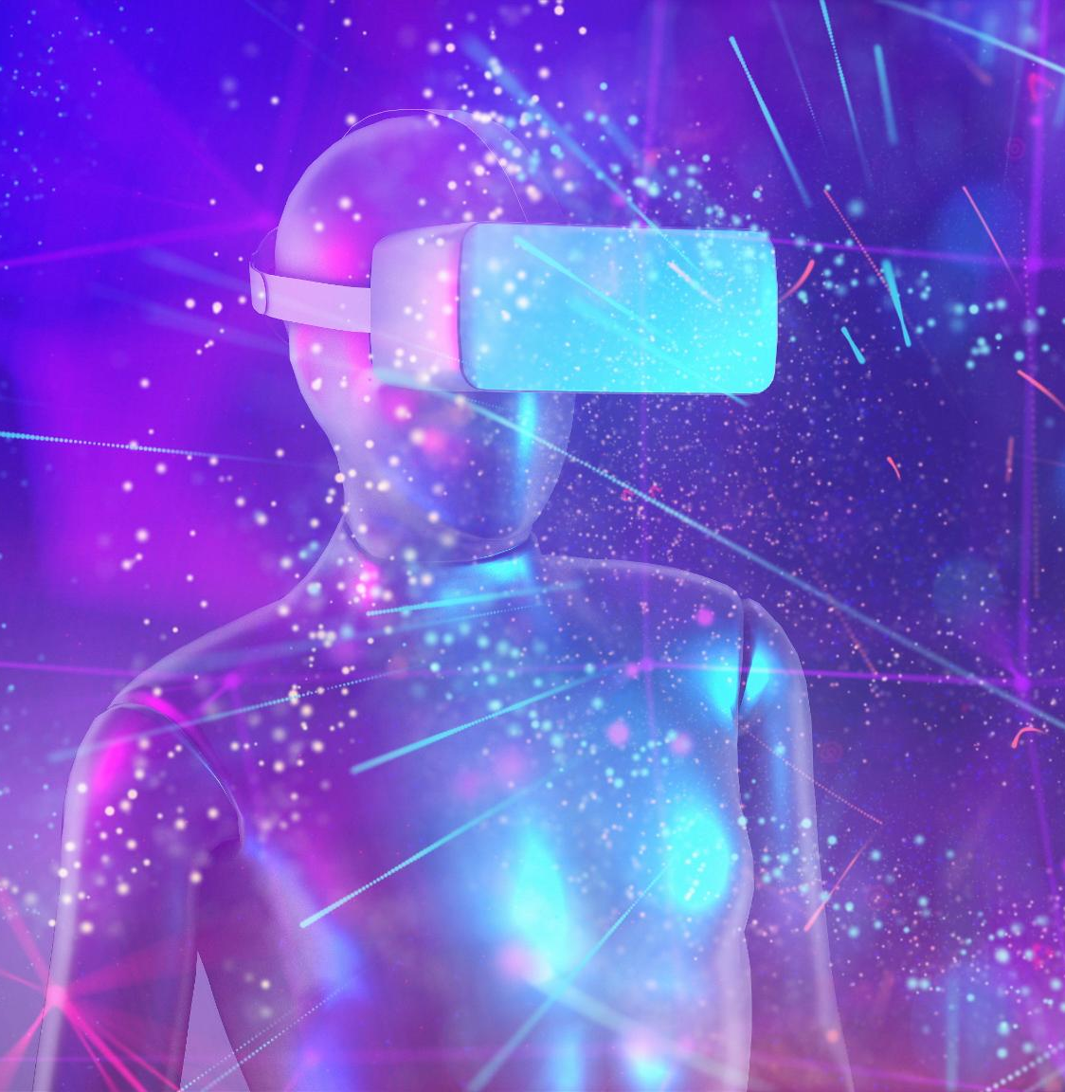
Agenda
Overview of AI in Entertainment
AI in Content Creation
AI in Media Consumption
Benefits and Challenges
Future Trends and Innovations
Notes:
--- In this presentation, we will cover an overview of AI's impact on entertainment, delve into its applications in content creation and media consumption, discuss the benefits and challenges, and speculate on future trends and innovations in the field. Image source: Microsoft 365 content library

Slide 3

Domain Overview & Importance
What is the domain? The entertainment and media industry spans film, television, music, gaming, publishing, and digital content platforms. It’s a $2.5 trillion global sector driven by storytelling, creativity, and audience engagement.
Why it matters?
Rising demand for personalized, immersive content
Pressure to reduce production costs and timelines
Globalization of content and multilingual accessibility
Competition from user-generated content and social media
AI is increasingly becoming integral to the entertainment industry, enhancing creativity and streamlining processes. Understanding the foundations and evolution of AI within this sector is crucial for grasping its current applications.

Slide 4
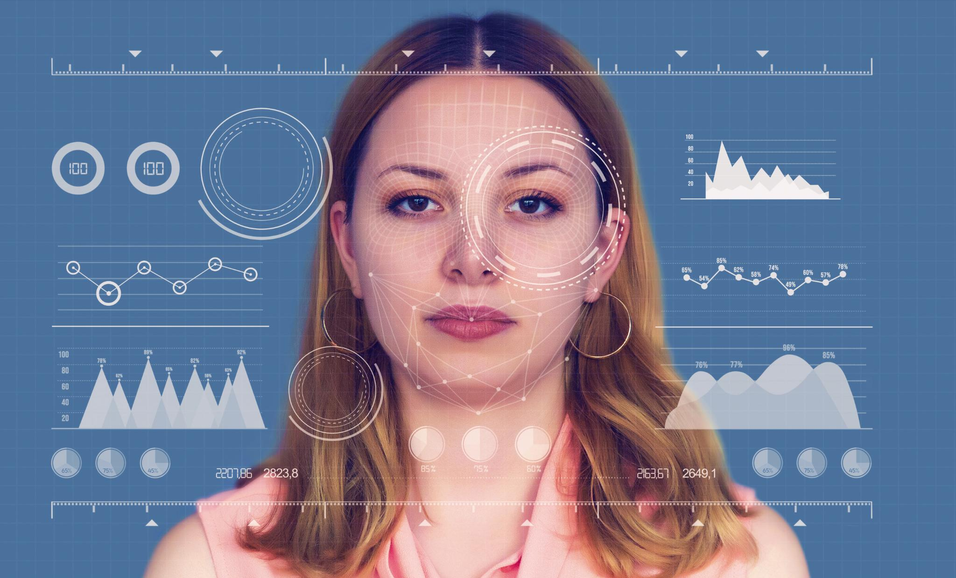
AI Use Case Motivation
Reducing Production Costs
AI technology significantly reduces production costs by automating complex tasks and enhancing efficiency in media creation.
Scalability Enhancement
AI improves scalability by speeding up processes and enabling the creation of large volumes of personalized content.
Personalized Content Creation
AI facilitates hyper-personalized content, allowing for unique and tailored media experiences for diverse audiences.
Actor De-Aging and Automation
AI, such as Disney Research's FRAN, automates actor de-aging, exemplified by its application in films like 'The Irishman', reducing post-production efforts.
Notes:
AI addresses high production costs, limited scalability, and the need for hyper-personalized content. A real-world example is AI video generation and actor de-aging. For instance, The Irishman used deep learning to make Robert De Niro appear younger. Tools like Disney Research's FRAN (Face Re-Aging Network) automate this process, reducing post-production effort significantly.

Slide 5
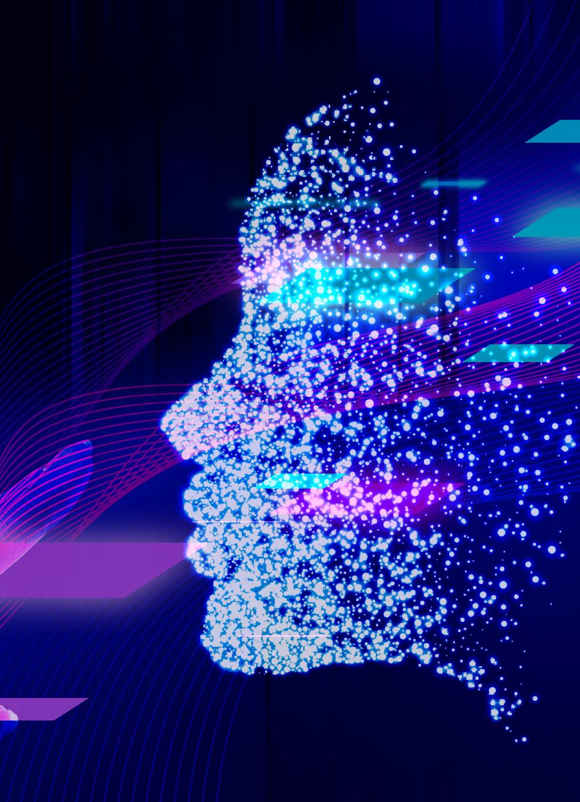
AI Techniques Used in Entertainment and Media
Generative AI (GANs, Diffusion Models): For video synthesis, character animation, and deepfakes.
Natural Language Processing (NLP): Scriptwriting, content summarization, and chatbots.
Computer Vision: Scene recognition, facial tracking, and VFX automation.
Reinforcement Learning: Adaptive game design and interactive storytelling.
Timeline (Optional):
2016: Deepfake tech emerges
2019: The Irishman uses AI de-aging
2023–2025: Agentic AI and real-time dubbing go mainstream
Notes:
--- Artificial Intelligence refers to the simulation of human intelligence in machines programmed to think and learn. This technology is being integrated into various entertainment platforms to enhance user experiences and create innovative content. Image source: Microsoft 365 content library

Slide 6
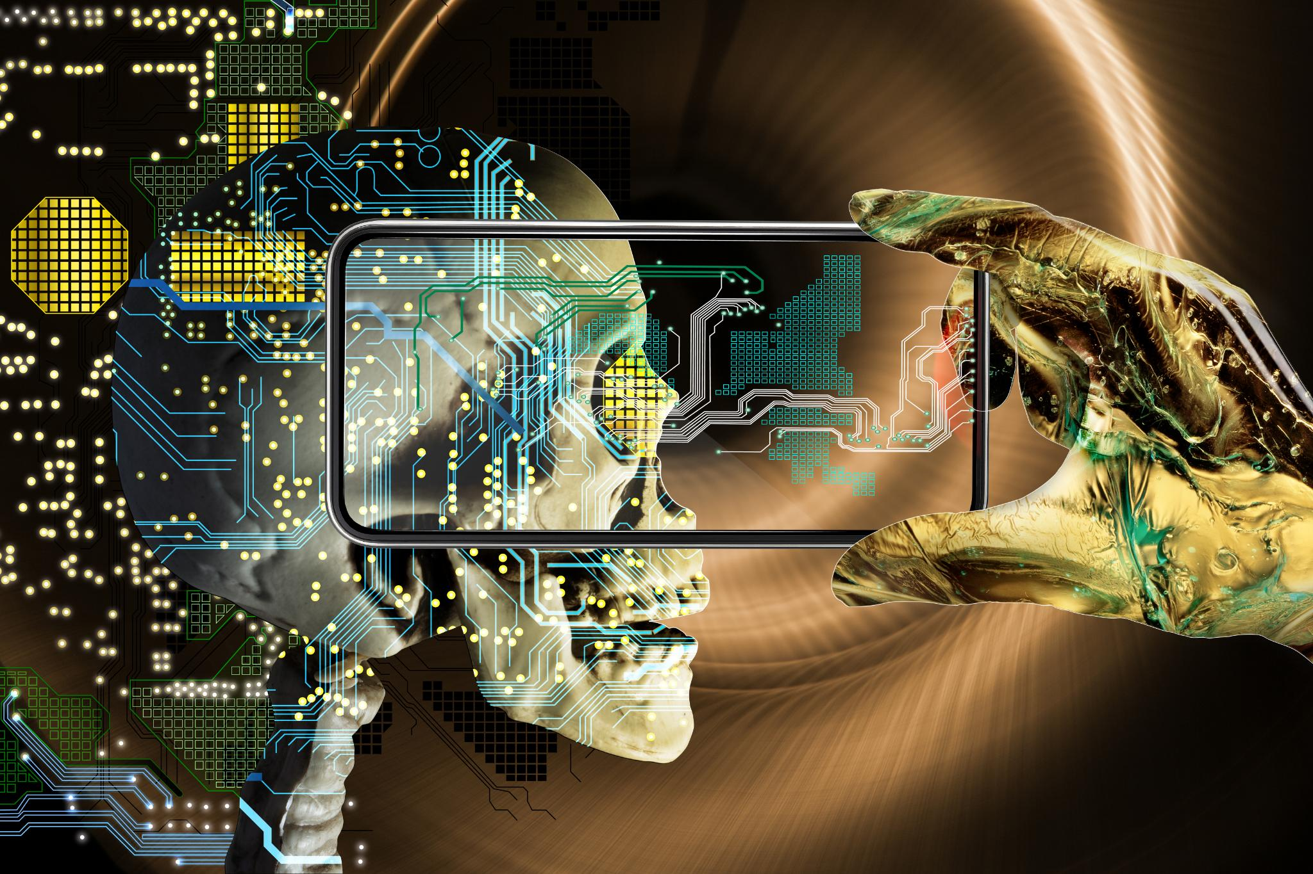
Historical Development of AI in Entertainment
Early Content Recommendations
The journey began with simple algorithms designed to recommend content based on user preferences, paving the way for AI integration.
Streamlining Production
AI evolved to streamline production processes in entertainment, enhancing efficiency and reducing costs for creators and studios.
Realistic Virtual Environments
Complex AI systems began to create realistic virtual environments, transforming gaming and filmmaking experiences for audiences.
Generating New Art
AI now generates entirely new works of art, showcasing creativity and pushing the boundaries of traditional artistic mediums.
Notes:
--- The journey of AI in entertainment began with simple algorithms for content recommendations, evolving into complex systems that streamline production, create realistic virtual environments, and generate entirely new works of art. Image source: Microsoft 365 content library

Slide 7
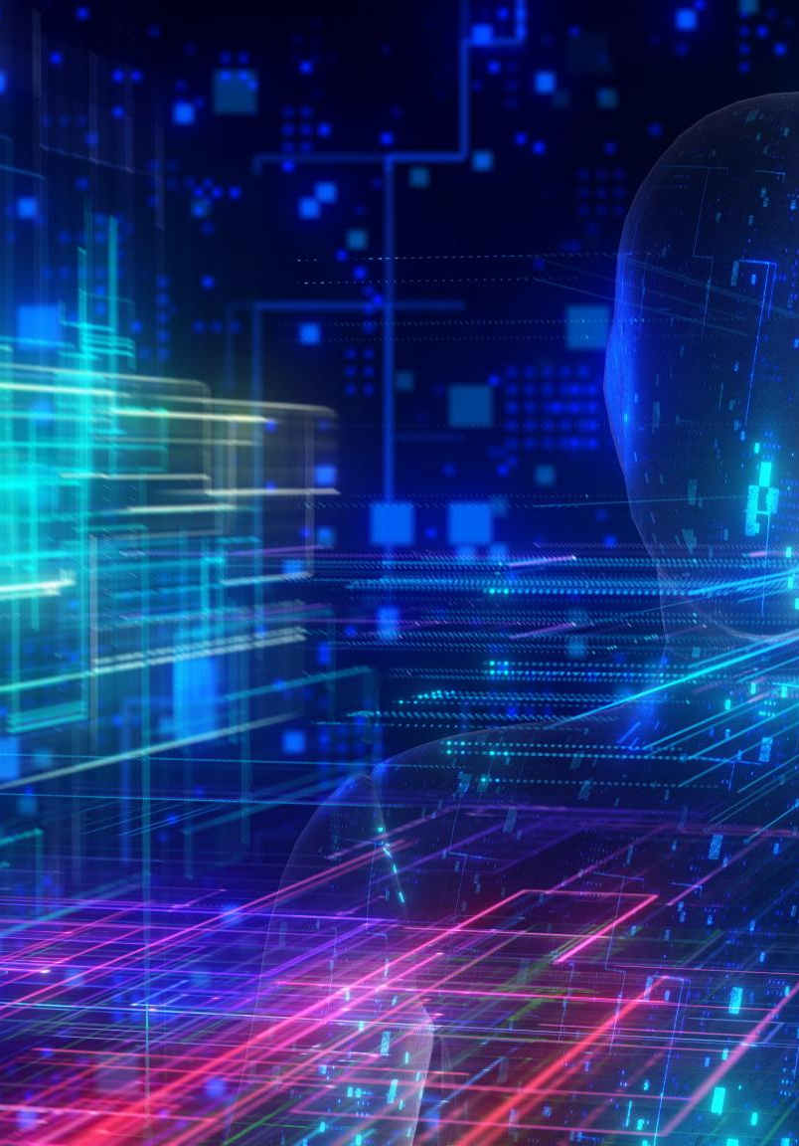
Key Technologies Driving AI
Machine Learning
Machine learning algorithms analyze data to make predictions and improve user experiences in entertainment applications.
Natural Language Processing
Natural language processing technology allows machines to understand and respond to human language, enhancing user interaction.
Computer Vision
Computer vision technology enables machines to interpret and process visual data, revolutionizing how we experience entertainment.
Notes:
--- Technologies such as machine learning, natural language processing, and computer vision are at the forefront of AI's application in entertainment. These technologies enable personalized experiences and enhance the capabilities of creators. Image source: Microsoft 365 content library

Slide 8
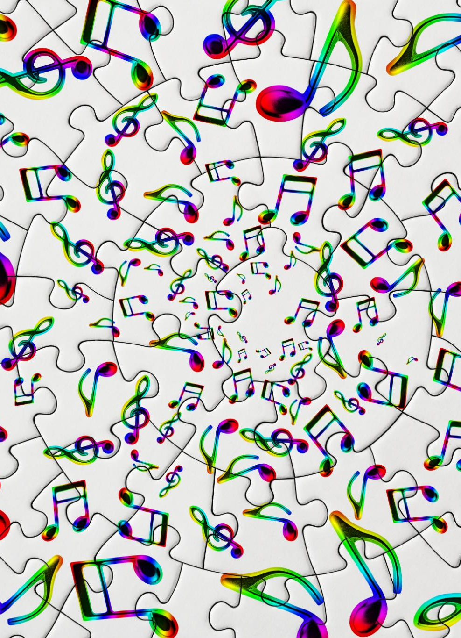
AI-Generated Music and Art
Creative Compositions
AI is revolutionizing the music industry by generating unique compositions that blend various styles and genres.
Visual Art Generation
AI tools have enabled artists to create stunning visual art pieces, pushing the boundaries of creativity.
Pushing Creative Boundaries
AI technologies, like AIVA and DALL-E, are expanding the possibilities of artistic expression and creativity.
Notes:
--- AI has made significant strides in generating music and art, allowing for the creation of unique compositions and visual pieces. Tools like AIVA and DALL-E exemplify how AI can push creative boundaries. Image source: Microsoft 365 content library

Slide 9
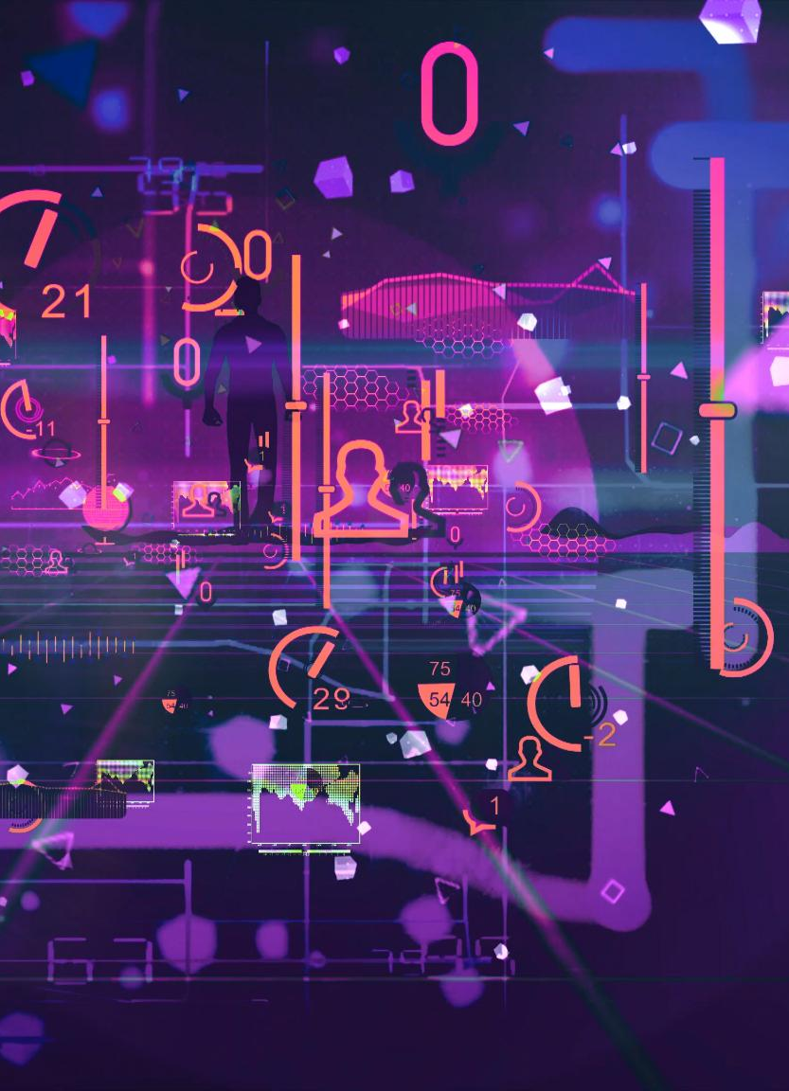
AI in Game Development
Smarter Non-Playable Characters
AI technology is making non-playable characters in games smarter and more responsive to player actions, enhancing immersion.
Adaptive Gaming Environments
AI enhances player experiences by creating adaptive gaming environments that respond to player behavior and choices.
Streamlined Content Creation
AI is streamlining content creation processes in game development, allowing for faster and more efficient design.
Notes:
--- AI is revolutionizing game development by enabling smarter non-playable characters, enhancing player experiences through adaptive gaming environments, and streamlining content creation processes. Image source: Microsoft 365 content library

Slide 10
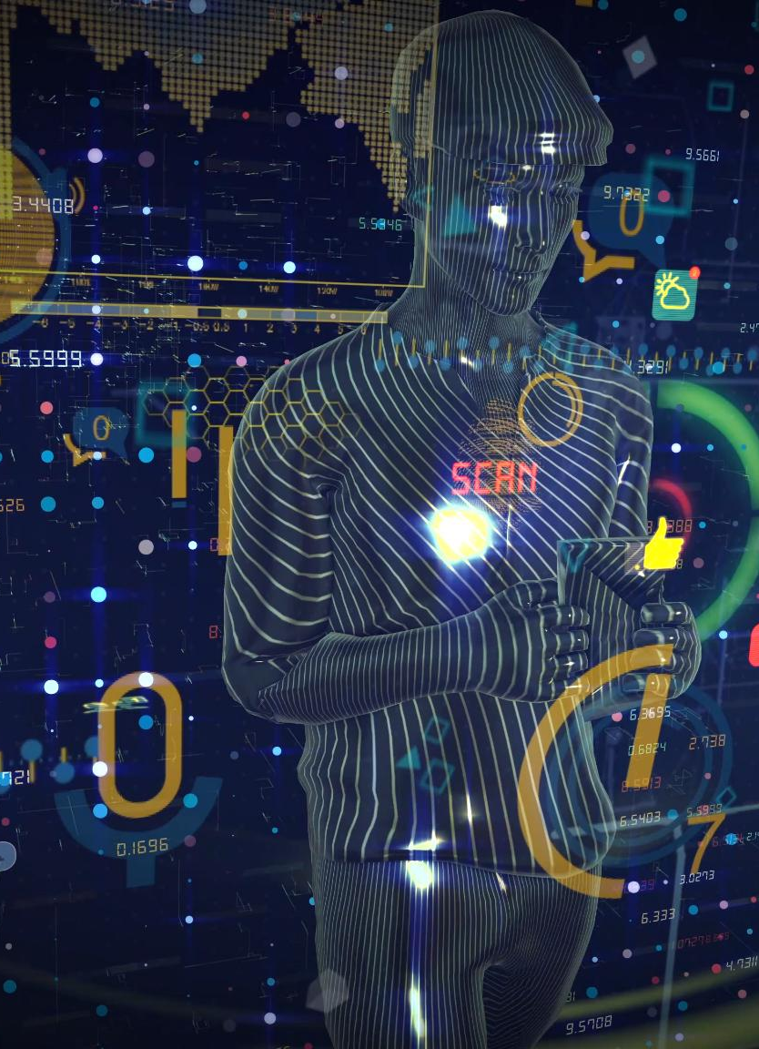
Personalized Content Recommendations
AI Algorithms in Streaming
Streaming services leverage AI algorithms to analyze viewer preferences, leading to personalized content suggestions.
Enhancing User Engagement
Tailored content recommendations significantly enhance user engagement by catering to individual viewer preferences and habits.
Improving Satisfaction
By providing relevant recommendations, streaming services improve overall user satisfaction, fostering loyalty and continued subscriptions.
Notes:
--- Streaming services use AI algorithms to analyze viewer preferences and behavior, providing tailored content recommendations that significantly enhance user engagement and satisfaction. Image source: Microsoft 365 content library

Slide 11
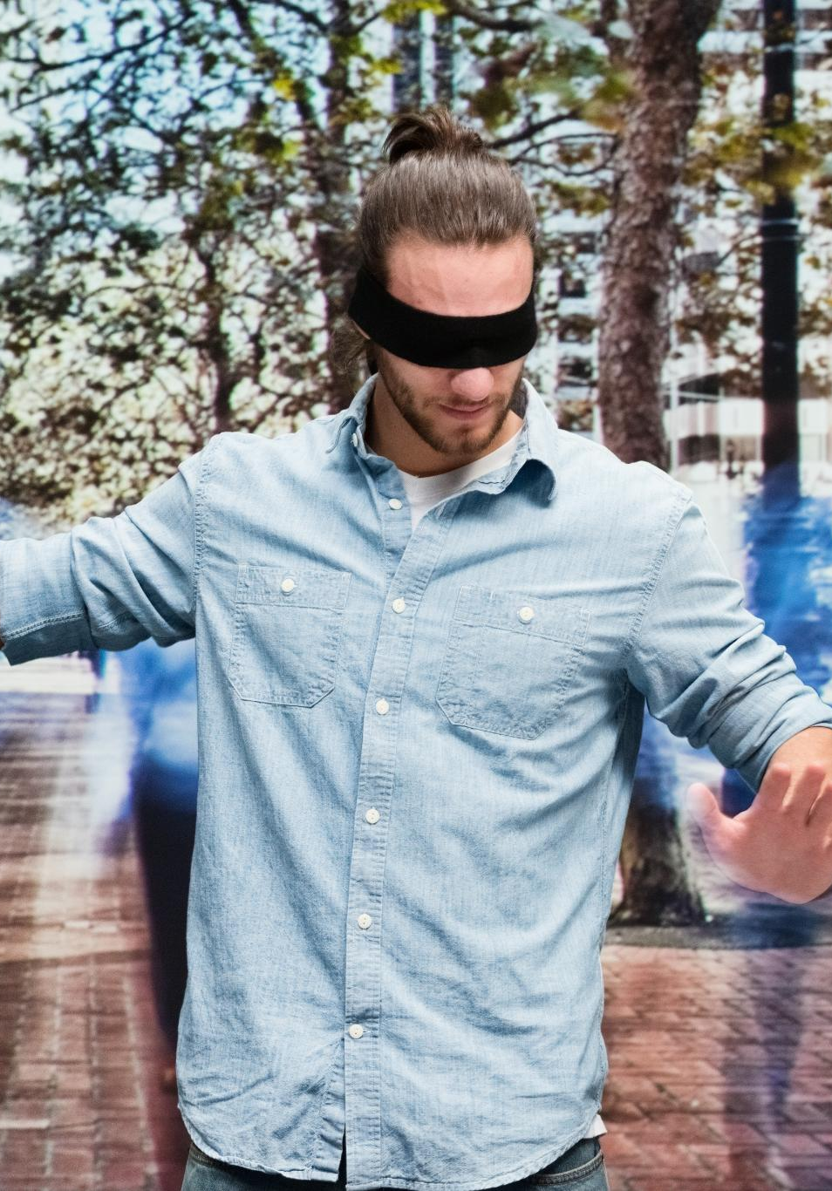
AI-Driven Interactive Experiences
Immersive Content Engagement
AI-powered experiences enhance audience engagement by transforming content interaction from passive viewing to active participation.
Virtual Reality Applications
Virtual reality enables users to enter simulated environments, providing unique opportunities for training, education, and entertainment.
Augmented Reality Features
Augmented reality overlays digital information onto the real world, enhancing user experiences in various applications, from gaming to education.
Notes:
--- Interactive experiences powered by AI, such as virtual reality and augmented reality, allow audiences to engage with content in immersive ways, transforming passive viewing into active participation. Image source: Microsoft 365 content library

Slide 12

Voice Assistants and Smart Devices
AI Integration in Devices
Voice assistants have integrated AI technology, enhancing user interaction with smart devices for seamless access to information.
Hands-Free Media Access
Smart devices offer hands-free media access, enabling users to enjoy content without manual input, improving convenience.
Personalized Viewing Experience
With voice assistants, users can personalize their media viewing experience, tailoring content recommendations to their preferences.
Notes:
--- Voice assistants and smart devices have integrated AI to facilitate content discovery and consumption, allowing users to access media hands-free and personalize their viewing experiences. Image source: Microsoft 365 content library

Slide 13
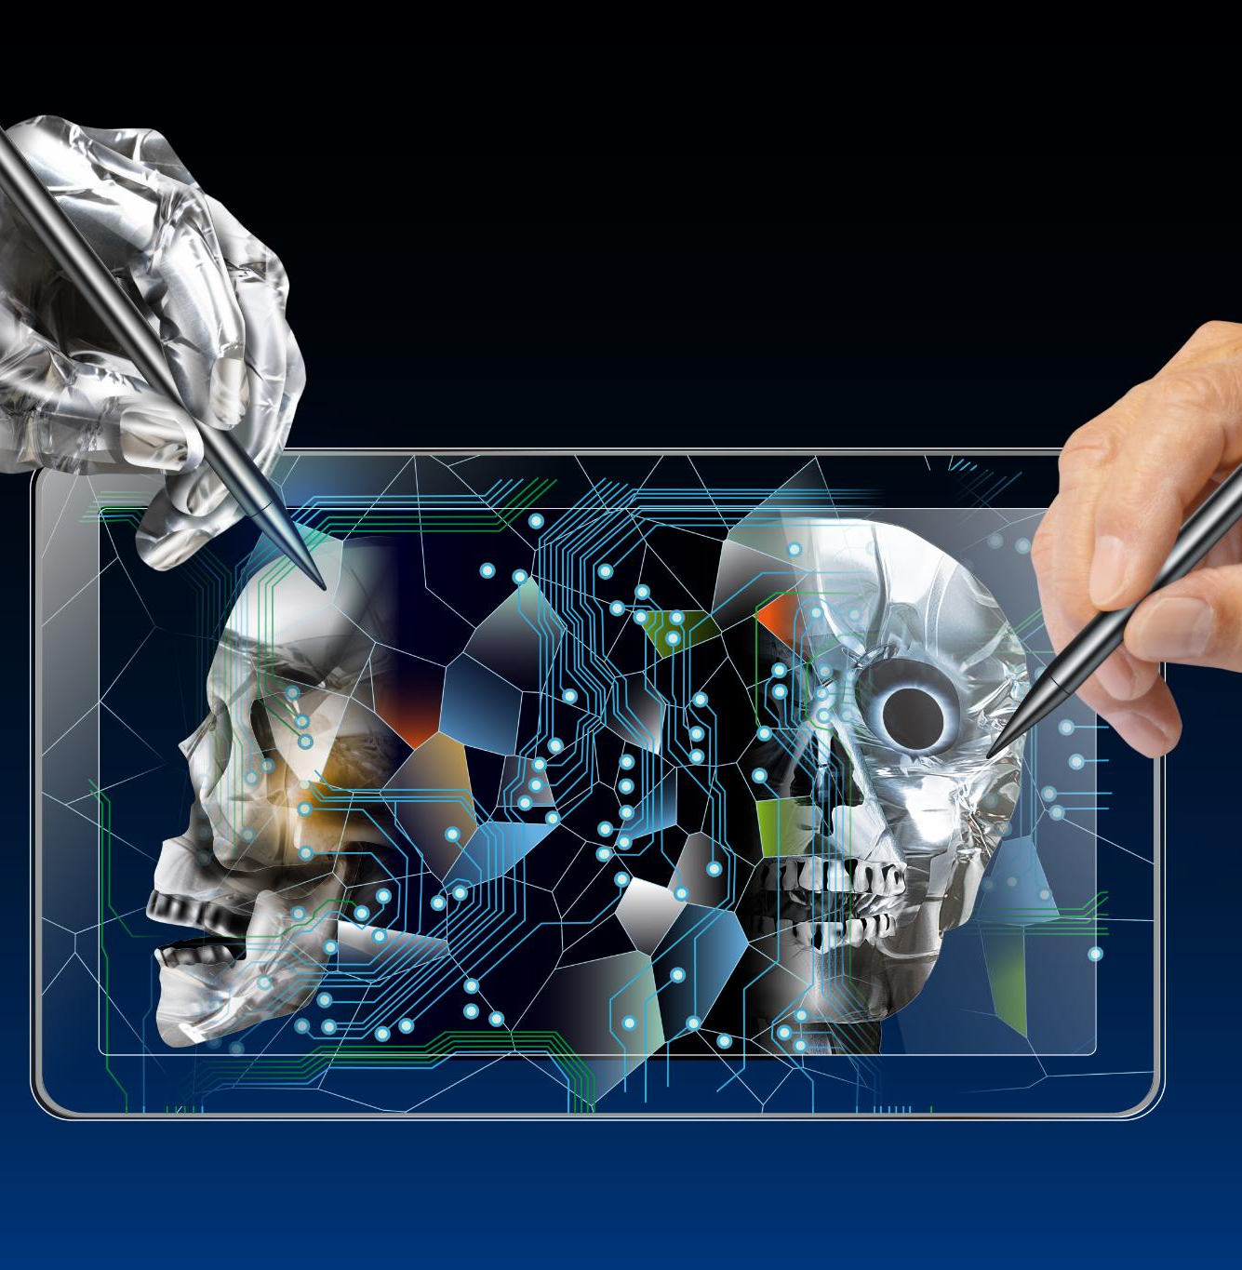
Enhanced Creativity and Efficiency
AI in Artistic Tools
AI tools significantly assist artists and producers in their creative process, enabling innovative expressions and enhanced productivity.
Improving Production Efficiency
With AI, production processes become more efficient, significantly reducing time and costs without compromising quality.
Notes:
--- AI enhances creativity by providing tools that assist artists and producers. It also improves efficiency in production, reducing time and costs while maintaining high-quality output. Image source: Microsoft 365 content library

Slide 14
Ethical Considerations
Copyright Issues
AI-generated content brings up significant copyright concerns, questioning the ownership of creative works produced by machines.
Authenticity Concerns
As AI creates content, authenticity becomes a critical issue, requiring vigilance to ensure that information is genuine and credible.
Bias in Content Generation
AI systems may inadvertently reflect biases present in their training data, raising concerns about fairness and representation in generated content.
Notes:
--- The implementation of AI raises ethical questions regarding copyright, authenticity, and the potential for bias in content generation, necessitating ongoing discussions about responsible use. Image source: Microsoft 365 content library

Slide 15
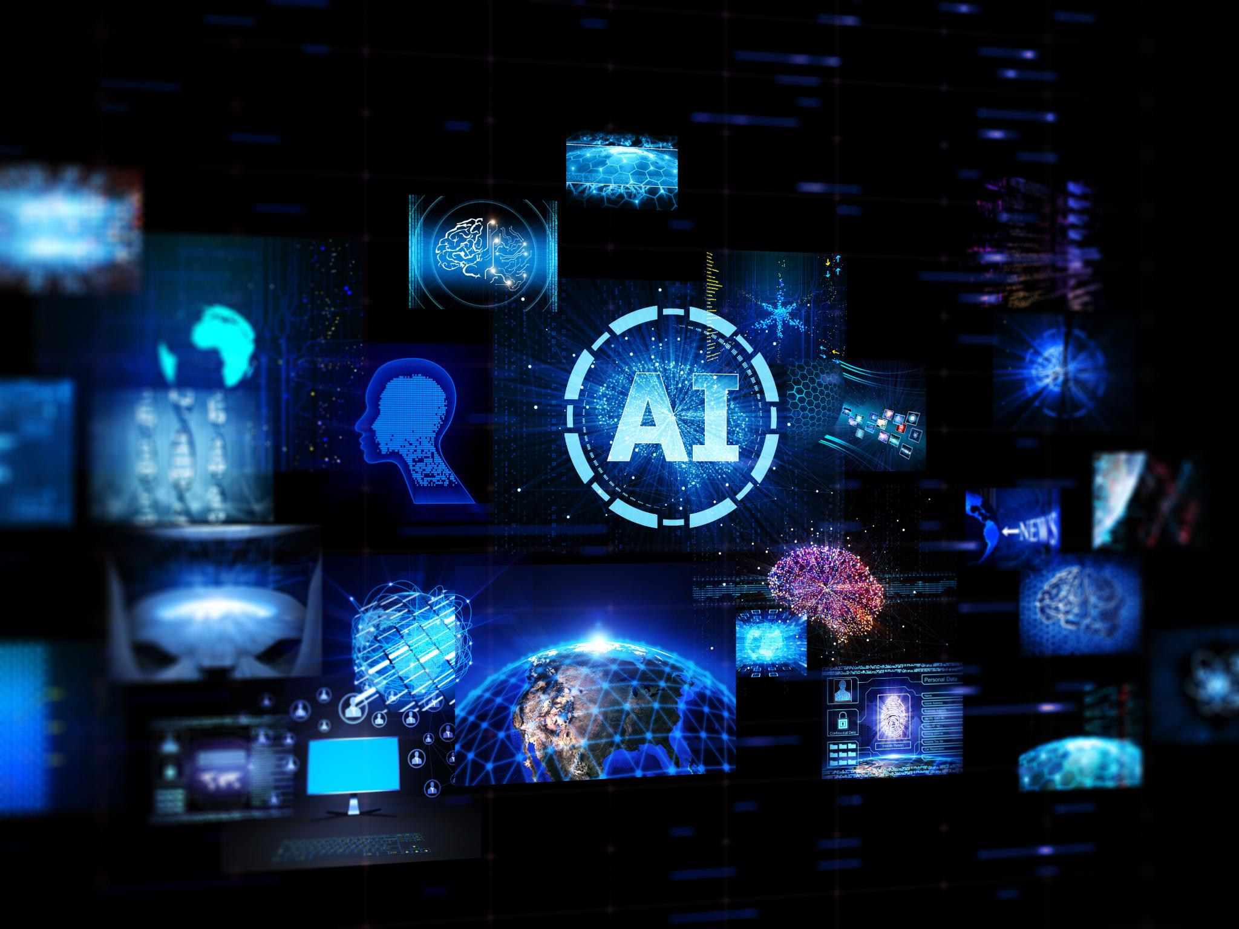
Impact on Employment
Automation of Roles
AI technologies may automate certain roles in the entertainment industry, changing the job landscape significantly.
New Job Opportunities
With the rise of AI, new roles will emerge focused on managing and overseeing AI technologies in entertainment.
Notes:
--- The rise of AI may lead to shifts in employment within the entertainment industry, as some roles may be automated while new opportunities arise in overseeing and managing AI technologies. Image source: Microsoft 365 content library

Slide 16
Predictive Analytics and Real-Time Data
Informed Decision Making
Predictive analytics enables producers to make data-driven decisions that enhance content creation and marketing effectiveness.
Optimizing Audience Engagement
Real-time data allows producers to tailor content to audience preferences, increasing engagement and satisfaction.
Revenue Generation
Utilizing predictive analytics helps identify trends that can lead to increased revenue through targeted marketing strategies.
Notes:
--- Predictive analytics using real-time data can help producers make informed decisions about content creation and marketing strategies, optimizing audience engagement and revenue. Image source: Microsoft 365 content library

Slide 17
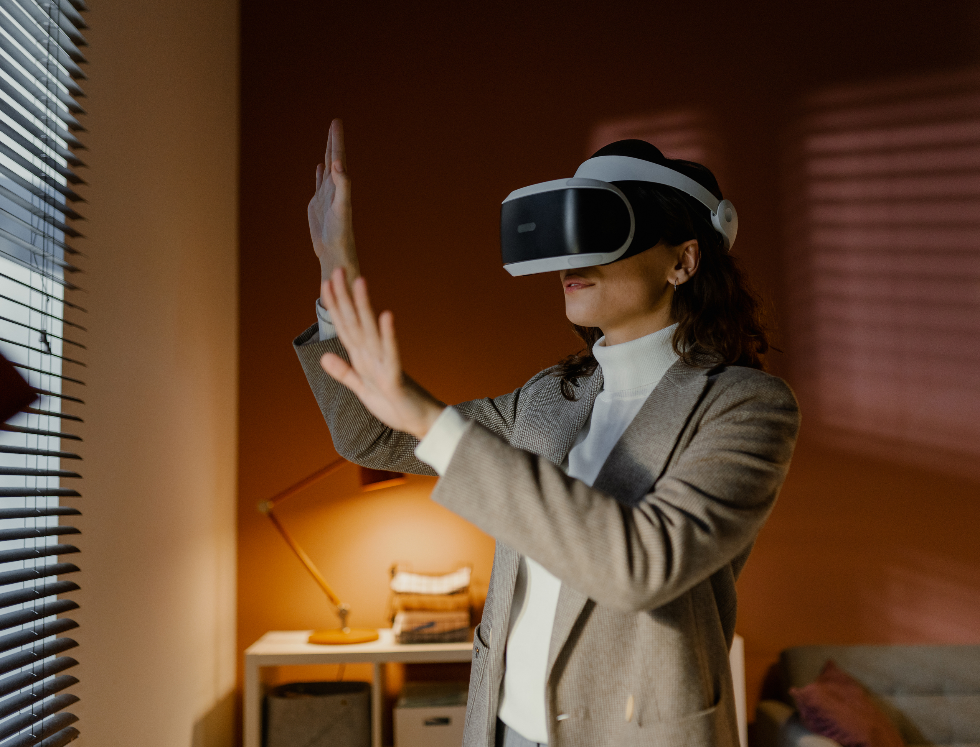
Virtual Reality and Augmented Reality
The combination of AI with virtual and augmented reality technologies will create even more immersive experiences, blurring the lines between the digital and physical worlds in entertainment
AI Integration
Integrating AI with VR and AR enhances user interactions, creating personalized and adaptive experiences in various applications.
Immersive Experiences
The fusion of VR, AR, and AI leads to highly immersive experiences that engage users like never before, especially in entertainment.
Blurring Digital and Physical
This technology blurs the lines between digital and physical realms, transforming how we perceive and interact with our surroundings.
Video - How AI is Reshaping the Media and Entertainment Industry?
https://www.youtube.com/watch?v=zZUCa6h4iac
Notes:
.

Slide 18
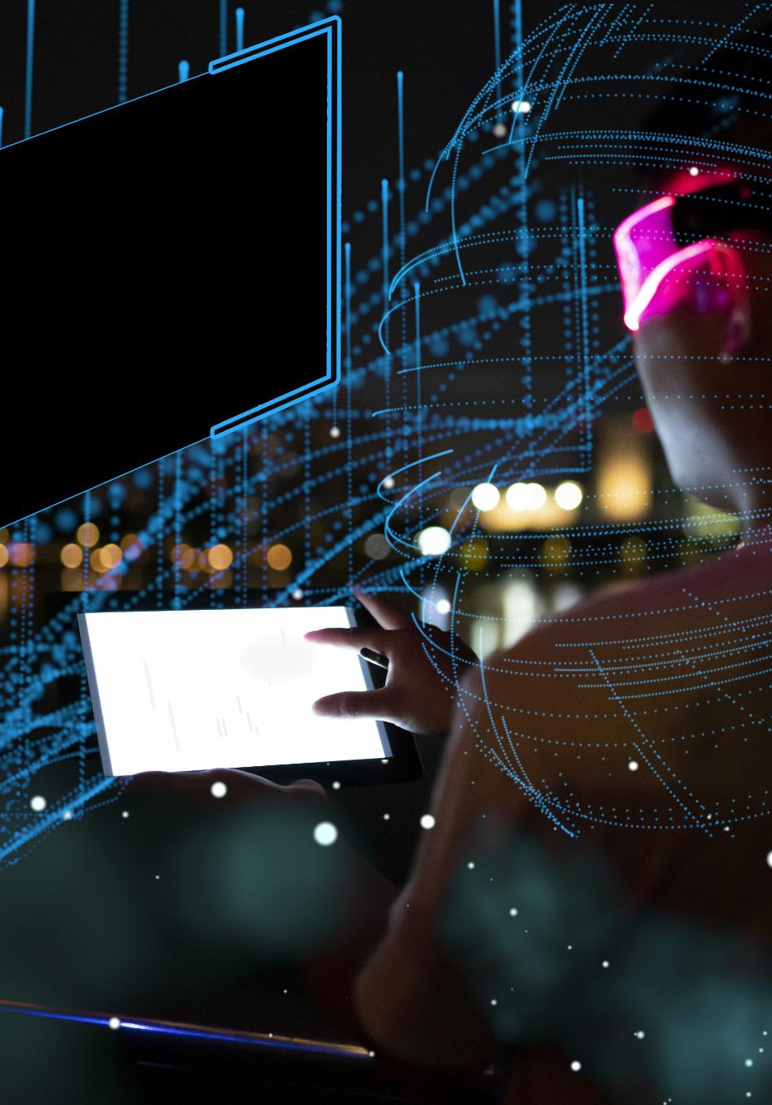
Potential for Further Integration
Advancements in AI Technology
The rapid advancements in AI technology are reshaping the foundations of the entertainment industry, enhancing creativity and innovation.
New Storytelling Forms
AI's integration is leading to the creation of unique storytelling formats, allowing for more engaging narratives and experiences.
Enhanced Audience Interaction
With AI, audience interaction is evolving, providing personalized experiences that redefine viewer engagement in entertainment.
Notes:
--- As AI technology continues to advance, its integration into the entertainment industry will likely deepen, leading to new forms of storytelling and audience interaction that we have yet to imagine. Image source: Microsoft 365 content library

Slide 19
Conclusion
Transformation in Entertainment
AI is revolutionizing how content is created and consumed, enhancing user experiences and personalization.
FINAL THOUGHTS
AI is undeniably transforming the landscape of entertainment and media, driving innovation in content creation and consumption. As we embrace these advancements, it is crucial to address the accompanying challenges and strive for a balanced approach.
Innovation in Content Creation
The integration of AI tools is fostering creativity and enabling new forms of storytelling and media.
Addressing Challenges
As we embrace AI advancements, we must also address ethical challenges and ensure responsible usage in media.

Slide 20

References
References & Acknowledgments
Amazon. (2024). AI-powered sports highlights and dubbing. https://www.amazon.com
Animaj. (2024). AI-first kids media company. https://www.animaj.com
Disney Research Studios. (2022). Face Re-Aging Network (FRAN). https://studios.disneyresearch.com
Midjourney. (2025). AI video generation platform. https://www.midjourney.com
Netflix. (2023). Personalization at scale: How AI drives discovery. https://about.netflix.com
OpenAI. (2023). ChatGPT (Mar 14 version) [Large language model]. https://chat.openai.com/chat
Reelmind.ai. (2025, May 15). [Video demonstrating APA citation rules for AI content]. Reelmind AI Video Generator. https://reelmind.ai
Sourcely. (2024). When and how to properly cite AI in MLA and APA formats. https://www.sourcely.net/resources/when-and-how-to-properly-cite-ai-in-mla-and-apa-formats
TURILYTIX. (2024, December 15). How AI is reshaping the media and entertainment industry [Video]. YouTube. https://www.youtube.com/watch?v=zZUCa6h4iac

